Slide 1


Transportation
Bristol
&
Weston-Super-Mare
Notes:
Hello all,
Welcome to this months Webinar which will be focused on Transportation.
There will also be time to ask questions about any of the info or details here on the presentation.

Slide 2


What will be covered in this session
Buses
Trains
E-scooters
Taxi's
Private/Personal Vehicles
All the services and companies that we talk about in this presentation are not Sponsoring or endorsed by UHBW they are recommended through feedback and mass usage.
Notes:
This is a rough list of what the Webinar will cover and we shall include tips and tricks on how to make your travel cheaper and things to be aware of when travelling.
All the services and companies that we talk about in this presentation are not Sponsoring or endorsed by UHBW they are recommended through feedback and mass usage.

Slide 3
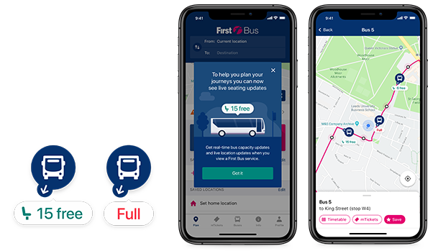
Bus
Useful Apps :
Stagecoach (The Stagecoach Bus App| Stagecoach Bus
First bus (First Bus App | First Bus)
You can plan your journey ahead of time with the planner option
Able to purchase ticket through the app so you will need to make sure you have a bank account in place.
Navigate yourself to nearby bus stops and see where the bus is with Live trackers
Notes:
Buses:
For Bristol we would advise downloaded the FirstBus app as see on the screen (Don’t worry a copy of the presentation will be shared at they end of the Webinar so you can access all these LINKS)
Live buses, Bus stops, Track routes of buses, Plan journey, Time table on bus stops, digital screens, Tickets on the phone keep phone charged, QR code on the tickets, contactless payments, Under 5 free year old, 16 and above will have a discounted,

Slide 4
Bus Tickets: Same for trains
Single – This is a one-way journey
(Example if there are 2 people travelling to one destination you would ask for 2 single tickets)
Return – This is a two-way journey
Day Tickets – This allows you to travel between certain destinations

Slide 5
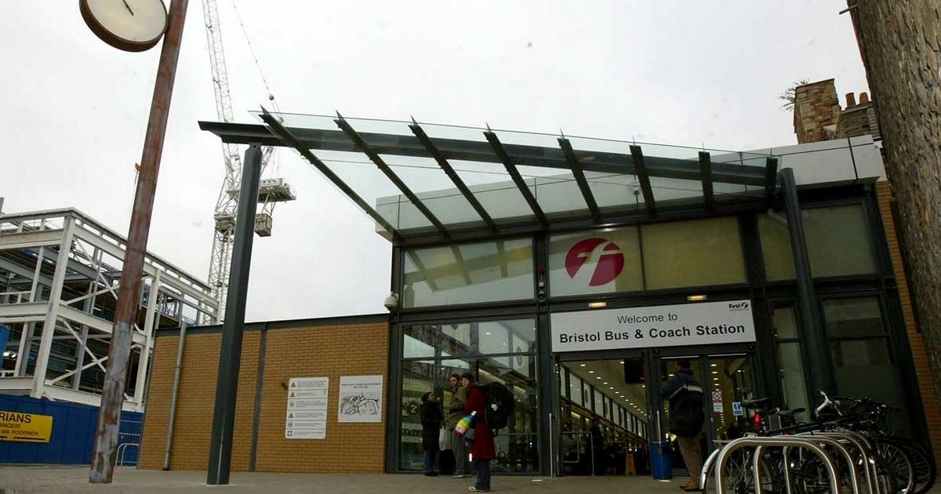
National Bus Services
Bus/Coach station
Bristol - Vale House, Cannon St, Bristol BS1 3NU
WSM – Interchange, WSM, BS23 1XY
Tickets Booking
Book tickets ahead through apps.
Kiosks pickup in bus station.
Note:
You must arrive early/on-time for your bus as they will not wait for you and you will be left behind!
National Express Coach on the App Store (apple.com)
National Express Coach - Apps on Google Play
Notes:
You can book your tickets ahead of time and save money as on the day travel long haul can be expensive.
You can also pick-up tickets for the Bus here at the station with dedicated kiosks to help answer any questions.

Slide 6
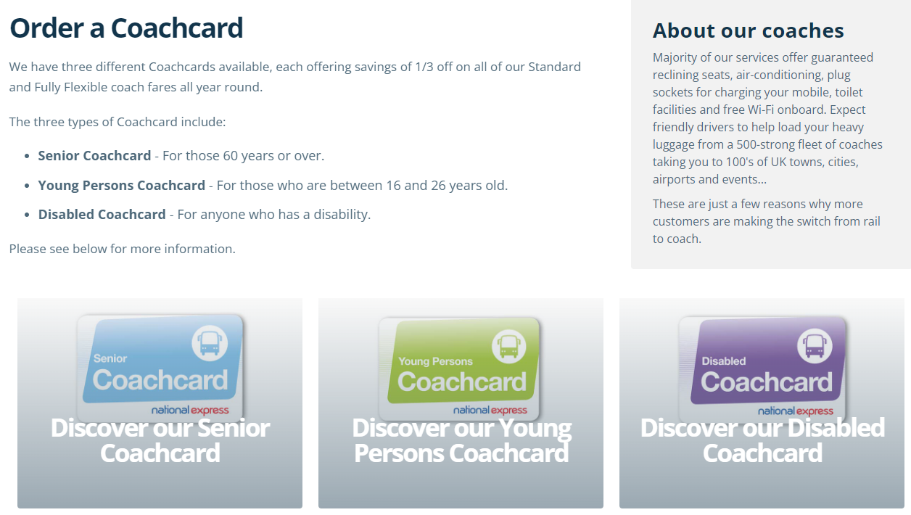
Coach Cards
Save on Travel with a Coachcard | National Express
Coach Cards can help you save money on your travels 1/3 off ticket prices for the year.
There is (Senior, Young and Disabled Coach cards)

Slide 7
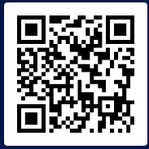

Train
Train Apps
The Trainline app is the most used app.
If you are looking to travel long distance, booking in advance with saves you money as on the day travel can be very expensive.
Travel destination – stops in the route, final train destination and often what Platform .
Train Stations
Bristol – Parkway & Temple Meads
WSM – Weston Super Mare & Worle
Scan Me to Download 'Trainline App'
Trainline App | Get a link (thetrainline.com)
Notes:
Trainline App - for booking and looking up travel on the trains for the whole of the UK.
The app helps tell you plan the journey giving you the train stations the train will stop at, the final train destination and often what Platform you will need to go on to catch the train (Though please do listen out at the Train Station as there could be last minute Platform alterations)
Note:
You must arrive early/on-time for your Train as they will not wait for you and you will be left behind and will have to wait for the next one and this can have a knock on effect to your journey

Slide 8
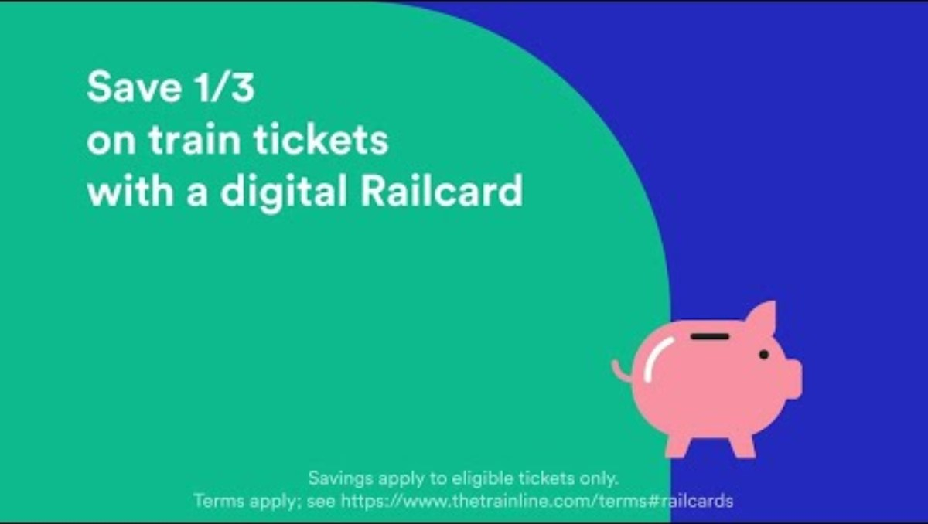
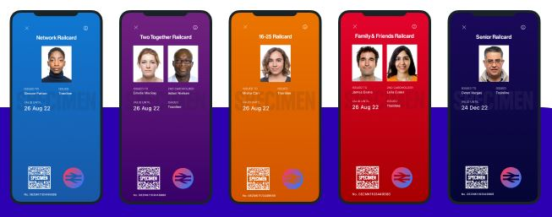
Train – What is a Railcard?
Is a discount Card that is stored directly in the Trainline app, so you can use it right away to get 1/3 off train journeys for a whole year.
The Video helps give a bit more detail about the Railcard and what it offers.
UK Digital Railcards for £30 | Buy Online with Trainline (thetrainline.com)

Slide 9
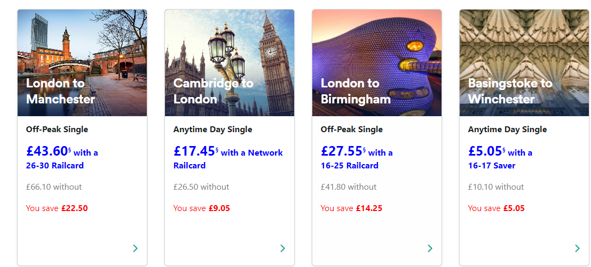
Examples of Railcard Savings:

Slide 10
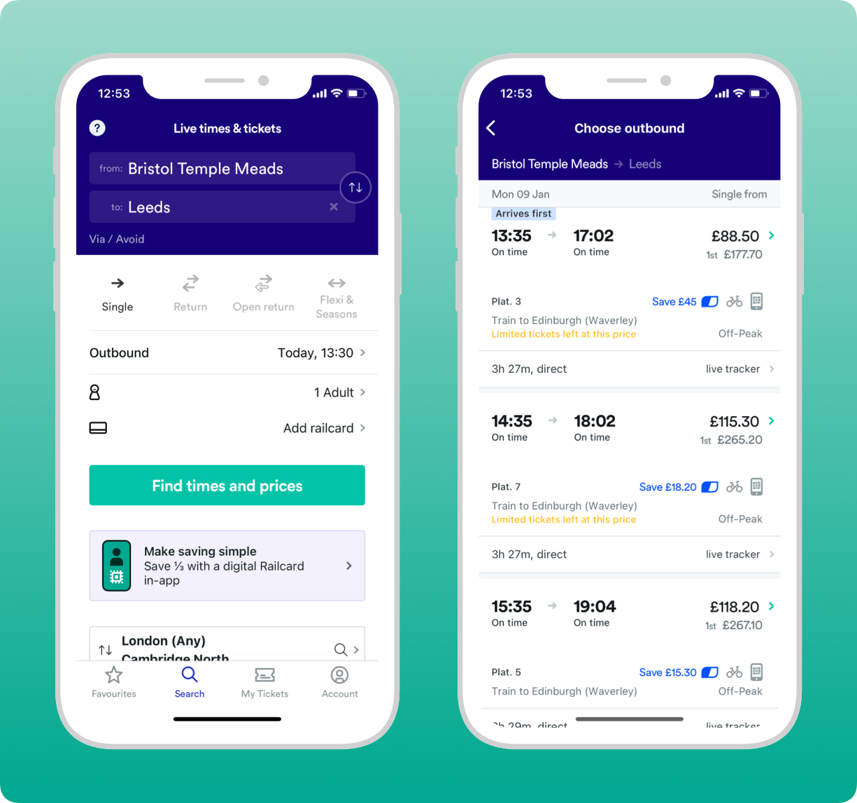
Categories of Railcard
There are various categories of railcard:
Network Railcard (London and Southeast England)
16-17 Saver
16-25 Railcard
26-30 Railcard
Family & Friends Railcard
Two Together Railcard
Senior Railcard
Disabled Persons Railcard
Veterans Railcard

Slide 11
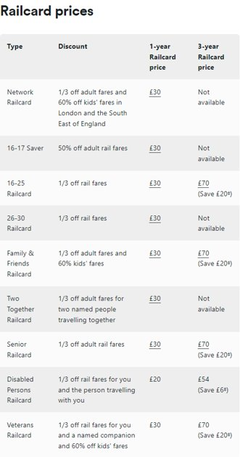
Railcard Prices & Categories
Please note that the Disabled Persons Railcard and Veterans Railcard are not available to buy with Trainline you will have to get these elsewhere

Slide 12


Any Questions so far?
Please feel free to turn your camera's on and unmute to ask questions
You can also use the chat function as well.

Slide 13
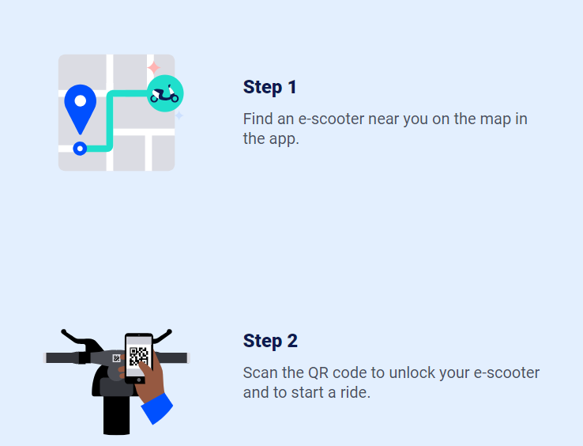
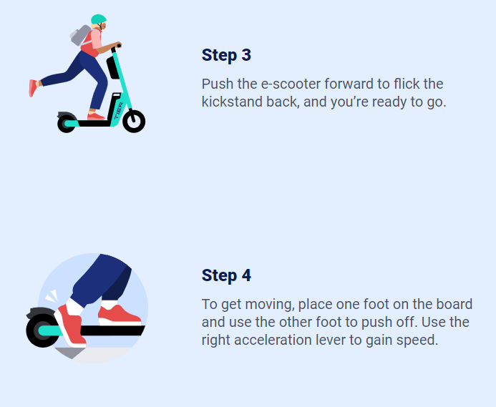
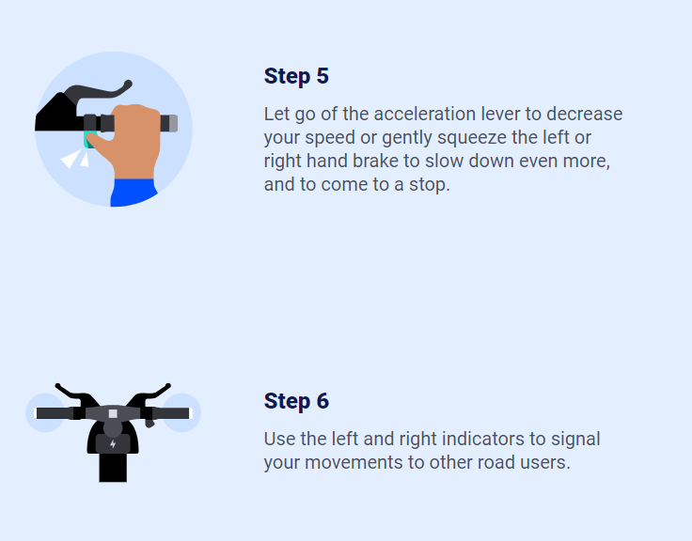
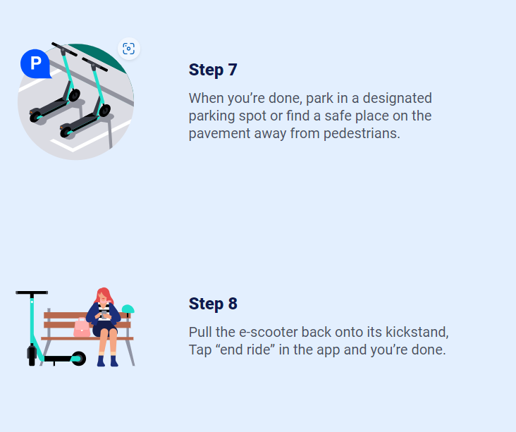
Tier E-Scooter

Slide 14
Tier E-Scooter
Things to Note:
Often you may be driving alongside traffic, please stay vigilant and always paying attention.
You will be banned from using Tier services if you are caught drinking an operating a scooter or passengering another person on the back of your scooter.
Safety equipment like helmets can help protect you should you have an incident
You will need to have a passport or ID and Bank Account to register
Notes:
Pick up from the destination, using apps, bank account linked and license, stop ride in the app and place the scooter in safe place.

Slide 15


Taxis
Uber
Bolt
Apple taxis
Prices will drastically increase with bad weather or if there is events/festivals in the area going on due to demand. The same thing will also happen with the time of day as typically Fri/Sat evenings are expensive as most people are going out/travelling.
Uber - Request a ride on the App Store (apple.com)
Uber - Request a ride - Apps on Google Play
Bolt: Request a Ride on the App Store (apple.com)
Bolt: Request a Ride – Apps on Google Play

Slide 16
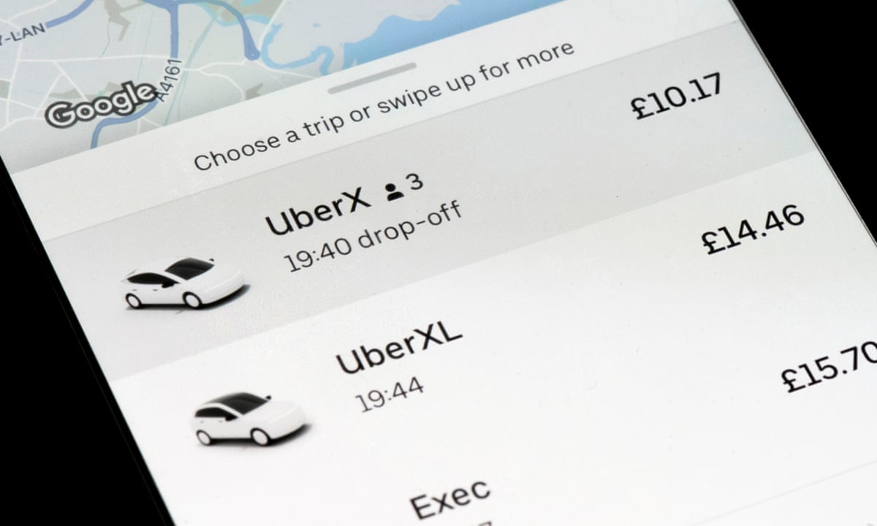
Uber:
Uber has several different options/styles of transport.
As you can see on the example on the side there are different sized taxis, and they also vary in prices so you will need to see on the app the price changes.

Slide 17


Private Vehicles
Documents Needed
Provisional or Full License
Insurance
V5,MOT,Vehicle Tax
Auto Trader UK - New and Used Cars For Sale
Cazoo | The better way to buy, sell and exchange a car online

Slide 18
Process of getting a car:
Find a Car
Check for Insurance Quotes
MOT & Tax
Change V5 Owner name

Slide 19
Private Vehicles
Drivers license – Direct Conversion
Andorra, Australia, Barbados, British Virgin Islands, Canada, Cayman Islands, Falkland Islands, Faroe Islands, Gibraltar, Hong Kong, Japan, Monaco, New Zealand, Republic of Korea, Republic of North Macedonia, Singapore, South Africa, Switzerland, Taiwan, Ukraine, United Arab Emirates and Zimbabwe
Driving in Great Britain on a non-GB licence - GOV.UK (www.gov.uk)
Exchange a foreign driving licence - GOV.UK (www.gov.uk)
Drive in a clean air zone - GOV.UK (www.gov.uk)

Slide 20

Thank you for attending!
All the information and links shared are no way endorsed or sponsored by us, these are recommended through searches we have done.
We always advise doing your own research and asking further questions, so you fully understand before making any commitments.
Check-out our new Pre-employment checks guide - Pre Employment Check guide - 1 (pagetiger.com)
If you have any further questions, please contact your Line Manager who will be able to assist, if you are unsure as to who that may be then you will need to reach out to your Recruitment Coordinator.

Slide 21
Any Questions?
Please feel free to turn your camera's on and unmute to ask questions
You can also use the chat function as well.

